Slide 1
NETFLIX
Twitter Stream Filter
Rupesh Dabbir

Slide 2
Features
Offline first Progressive web app (PWA)
Babel / webpack / react.js / node.js
Customizable Filter engine written in react.js
client side rendered
CI/cD over Heroku (super automated)
Paginated data and configurable tweets.

Slide 3
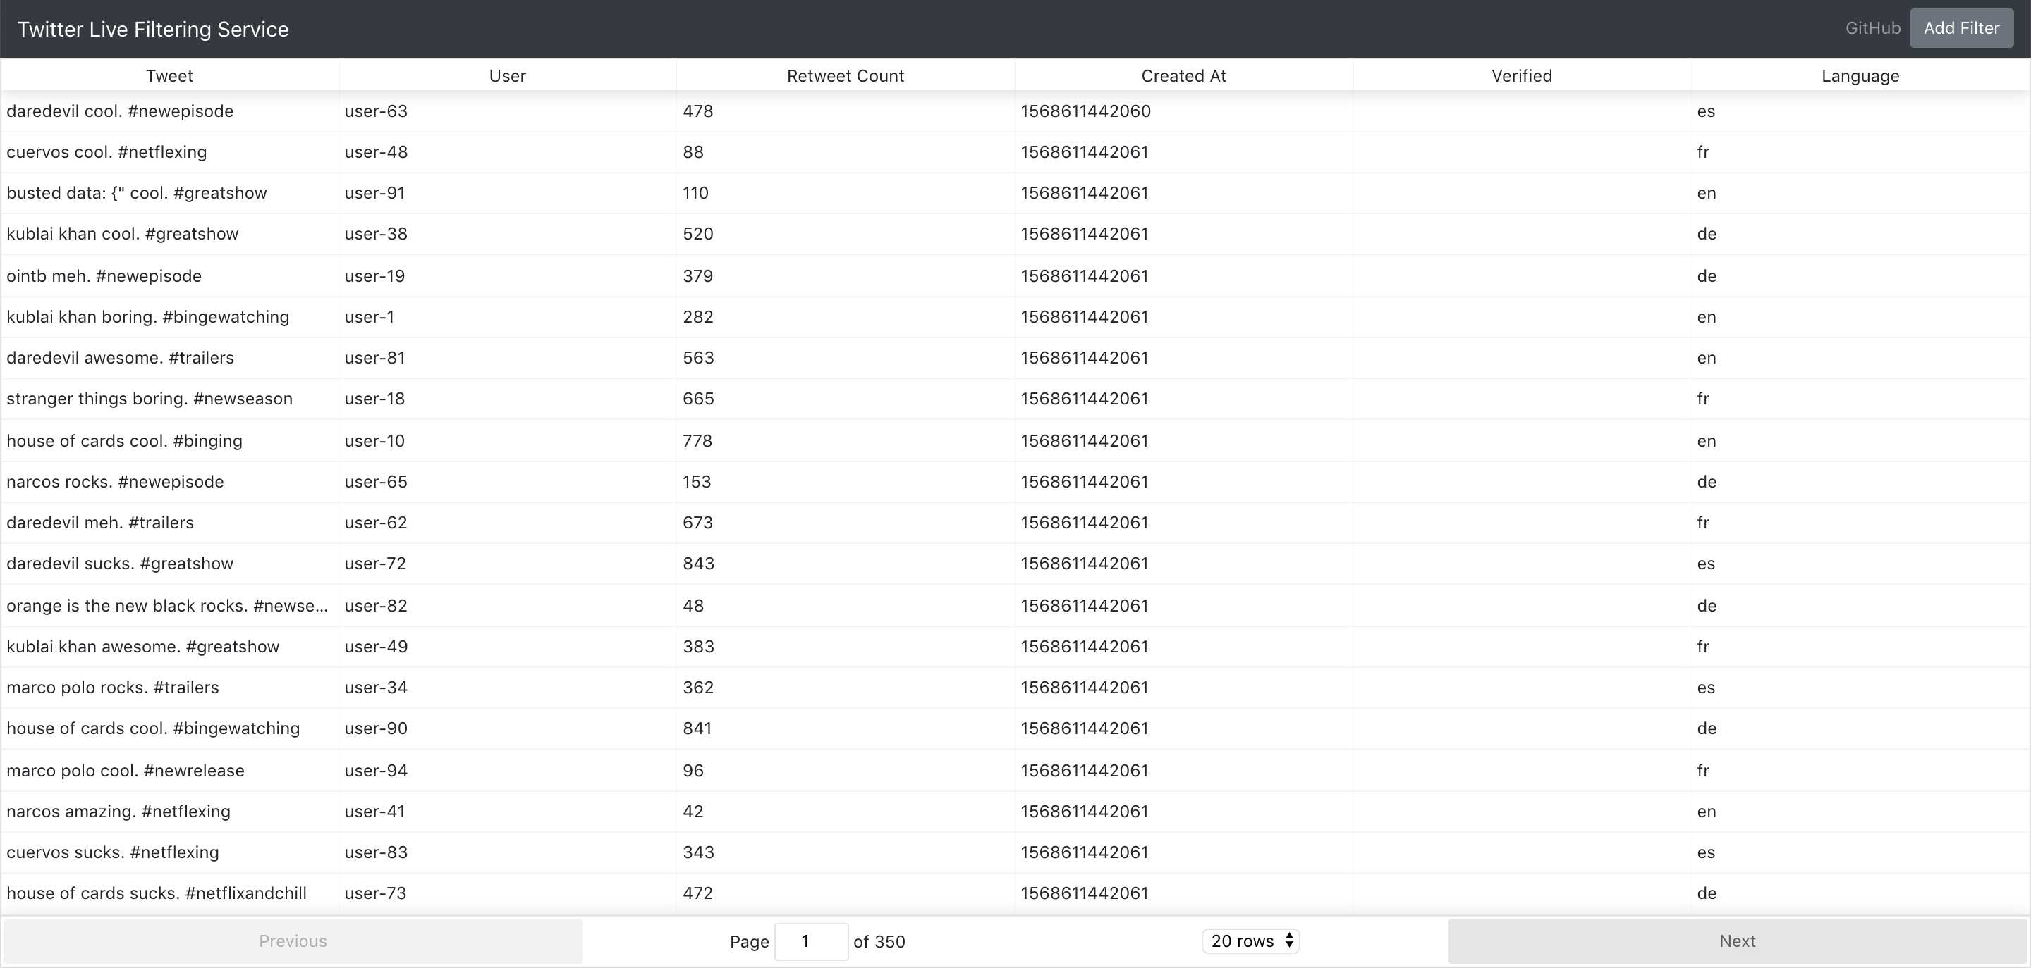
Dashboard
Dynamic Table (Sorting etc)
Paginated data.
Customizable show results (default: 20)
Page keeps updating dynamically as we get more data.

Slide 4
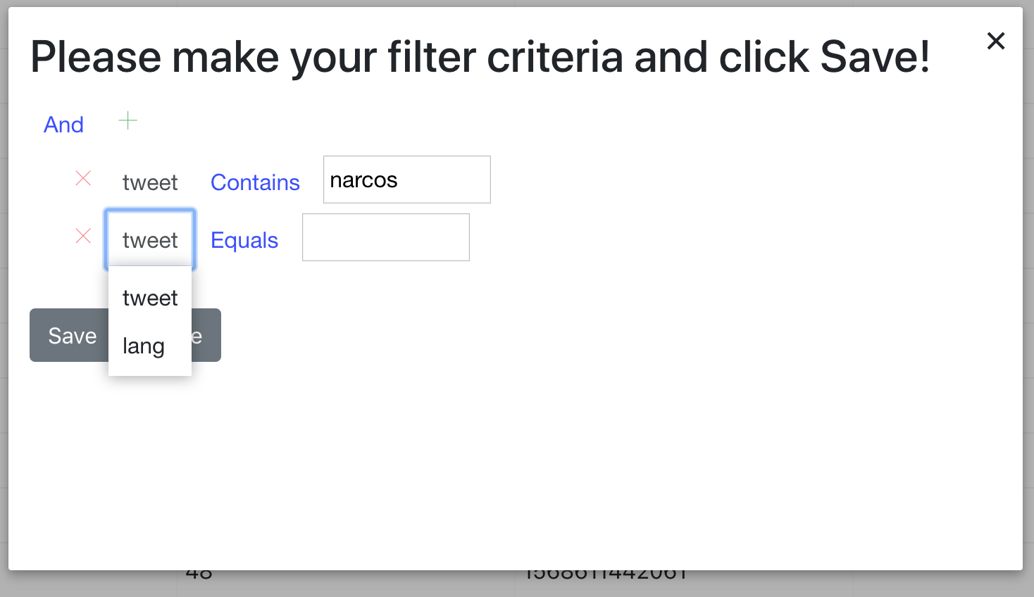
Filtering engine
Customizable filter engine.
Ability to add multiple queries ranging from:
EQUALS
Contains
Regular expression matching.

Slide 5
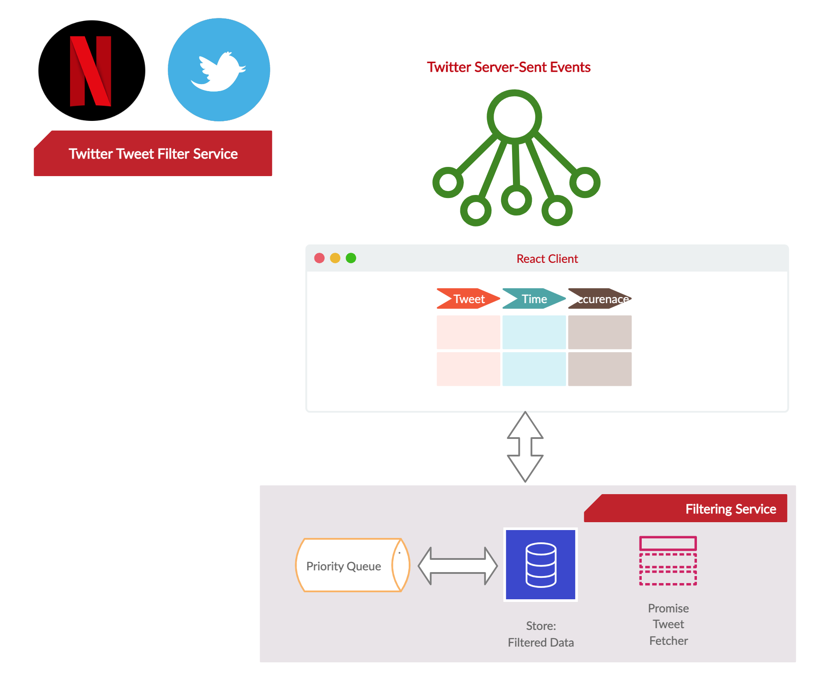
Architecture
Client driven architecture.
Priority queue (Max-heap) for quick storage and access to first n records.
Filtering engine built in react for filtering data.
Promise async runner for fetching tweets in async fashion.

Slide 6
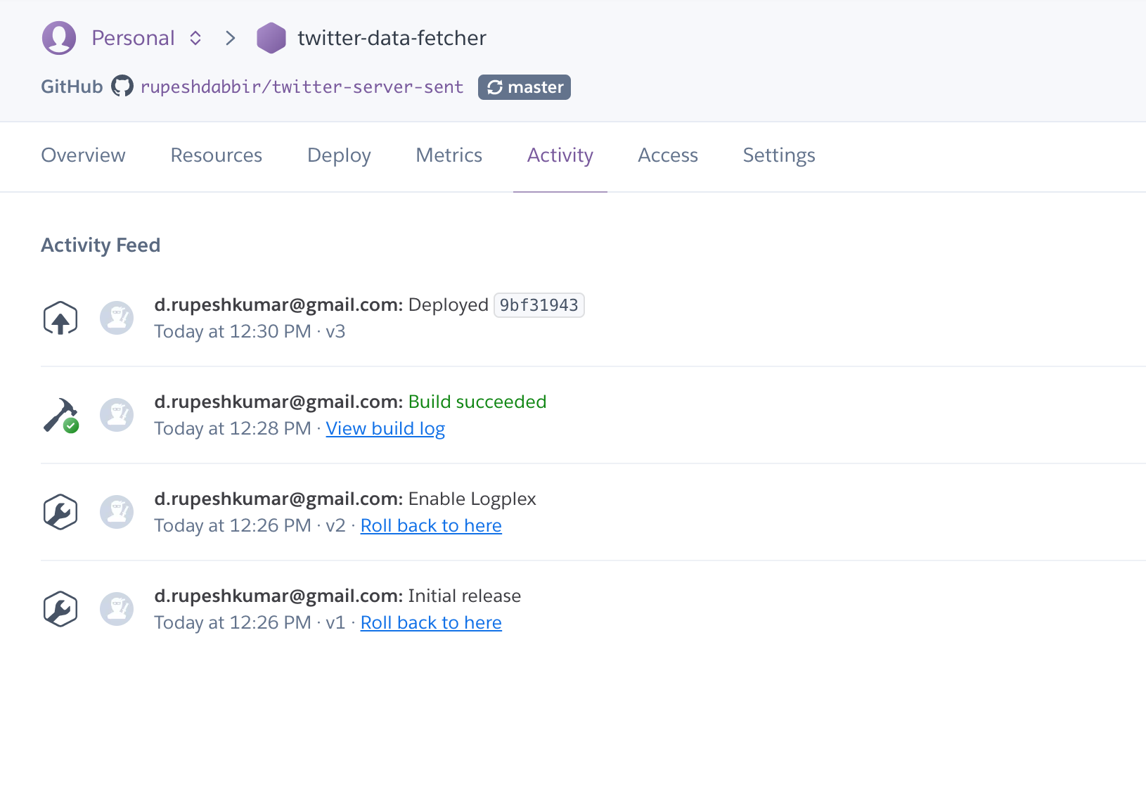
CI/CD
Completely automatic Ready-to-deploy “ONE CLICK” solution.

Slide 7
future improvements
Implement Server side rendering.
Clear filter feature / edit filter feature.
Use GRPC server side for client-server connection.

Slide 8
Thank you for watching!

